Slide 1
Origin-Destination pairs
ODs to choose from for plots on paper.
Different routing according to the different optimization objectives.
Changes in thickness represent the number of users traveling on the route.

Slide 2
Car-Bike
OD-pairs which change from using AMOD vehicle to bike when the optimization goal changes.
1. Under Utilitarian Efficiency operation users are assigned AMOD vehicle.
2. Under Commute Sufficiency operation a portion of the users previously assigned to the AMOD vehicle now must travel by bike.
3. Under Trip Sufficiency operation all users traveling between the OD-pair must travel by bike (an AMOD vehicle is not assigned).
These OD-pairs’ trips are short and close to the city center.

Slide 3
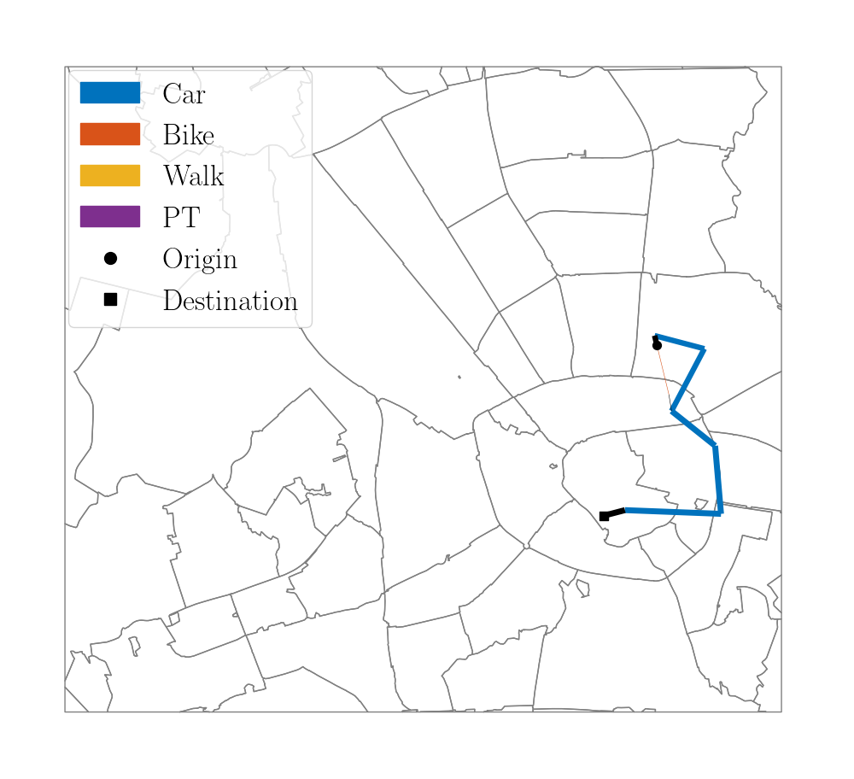
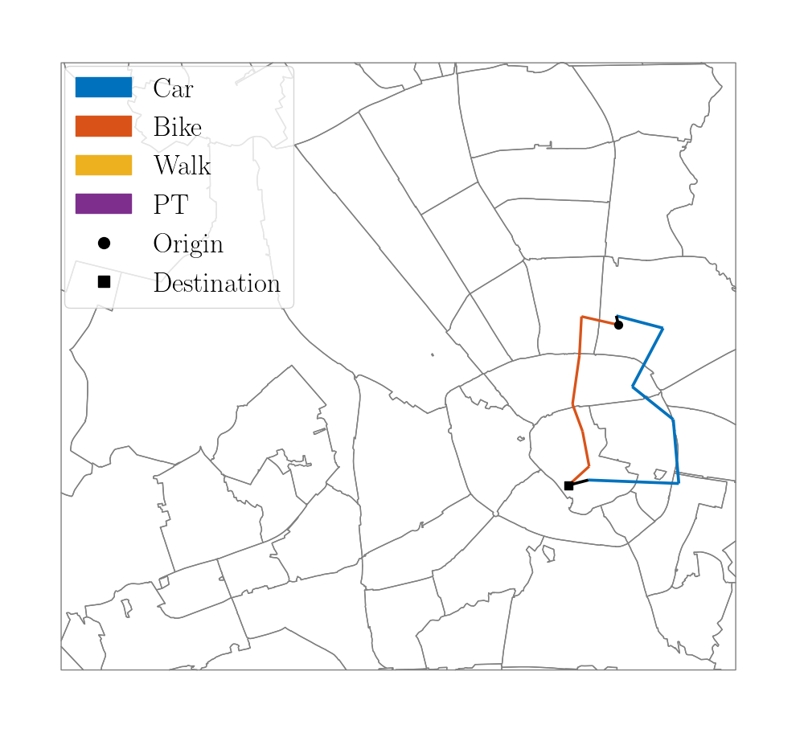
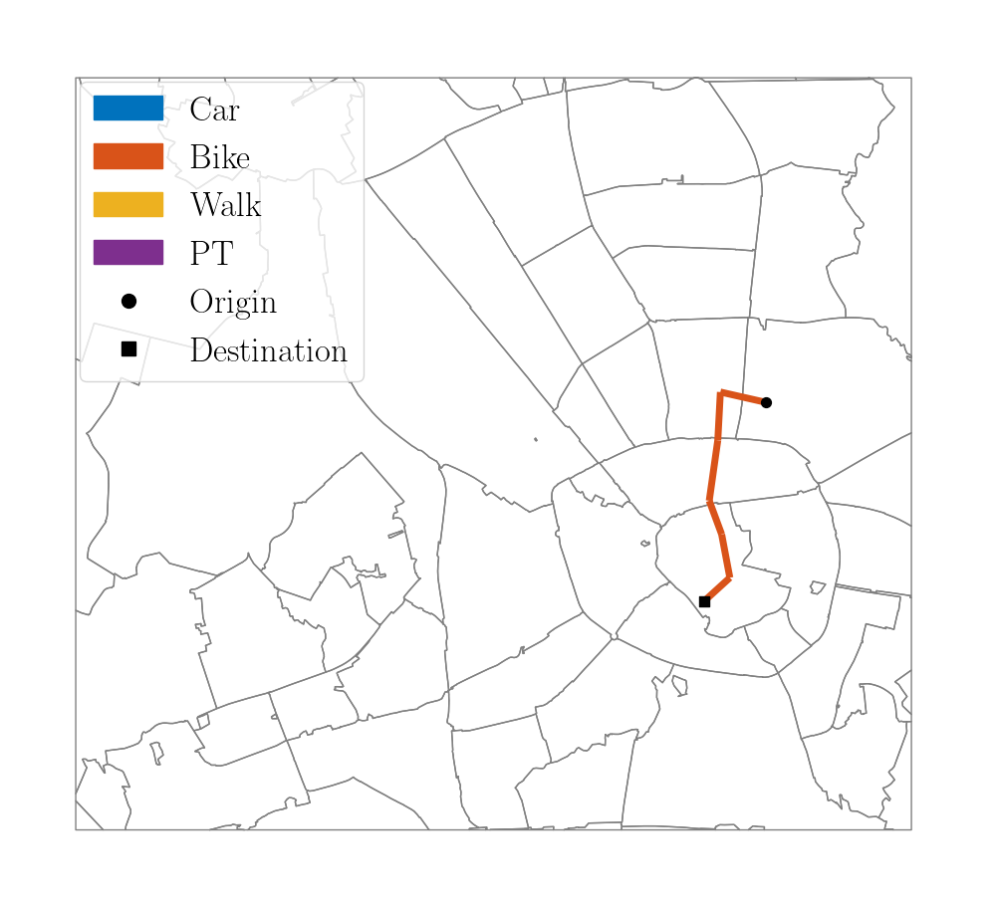
Car-Bike
OD: 253
Utilitarian Efficiency
Commute Sufficiency
Trip Sufficiency

Slide 4
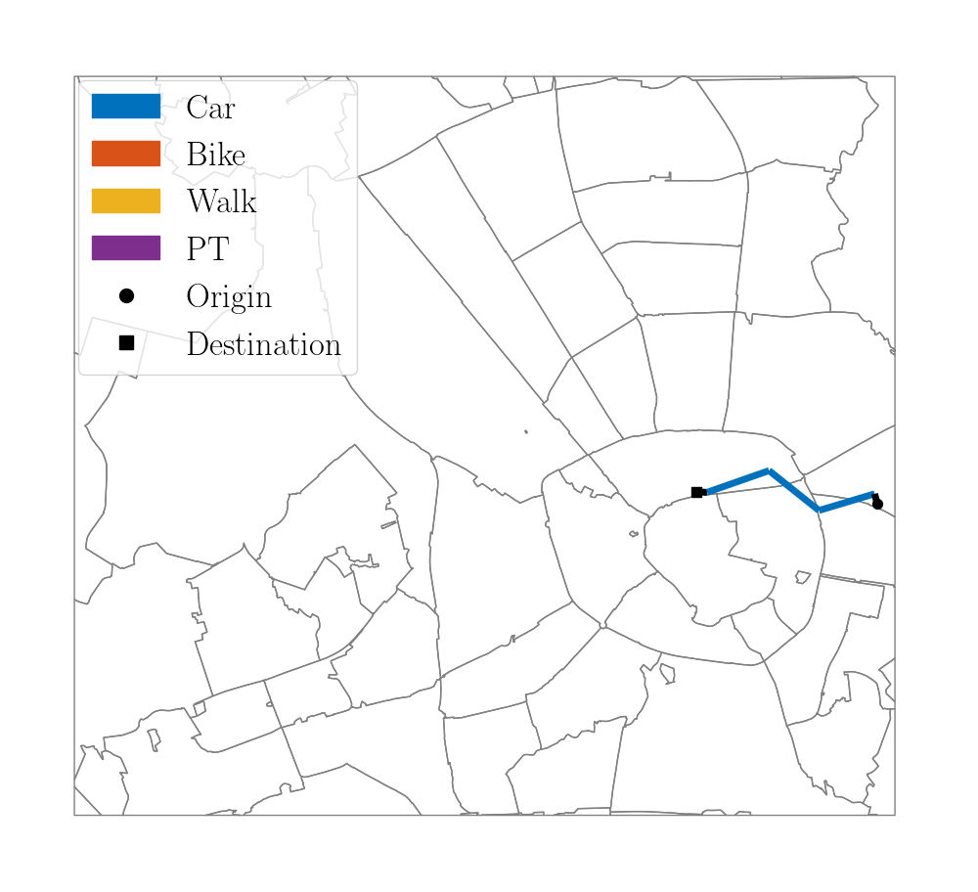
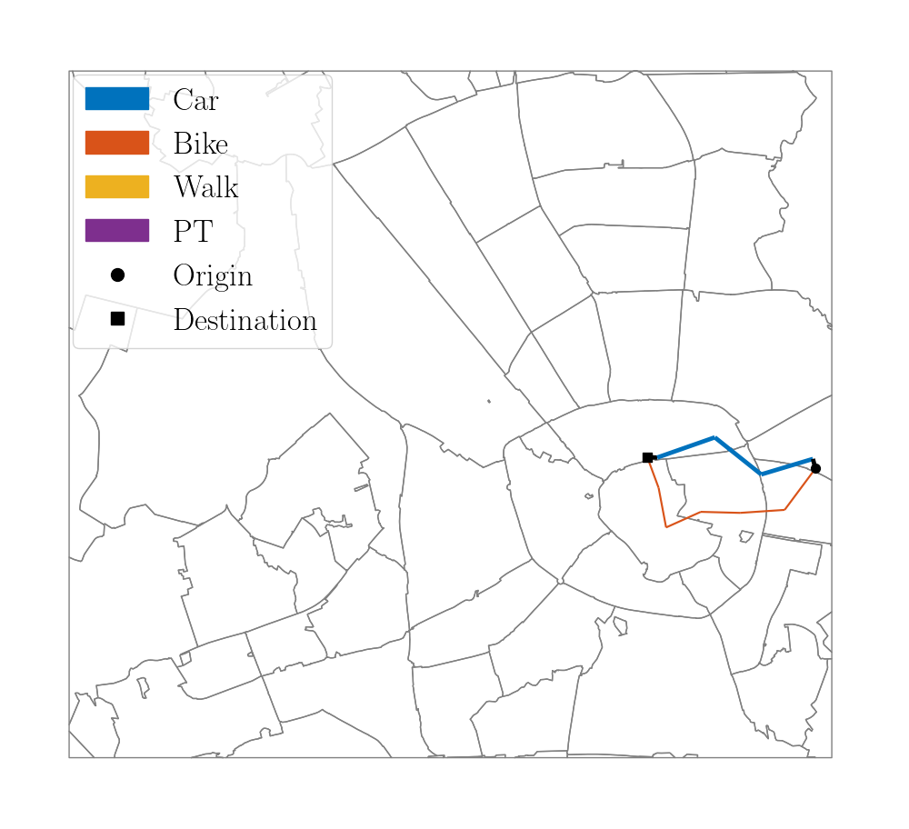
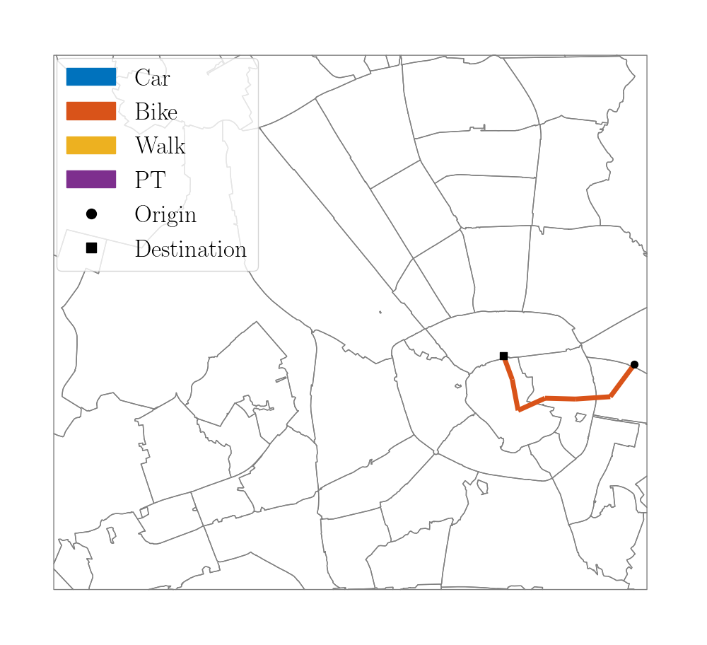
Car-Bike
OD: 361
Utilitarian Efficiency
Commute Sufficiency
Trip Sufficiency

Slide 5
Bike-Car
OD-pairs which change from using bike to AMOD vehicle when the optimization goal changes.
1. Under Utilitarian Efficiency operation all users traveling between the OD-pair must travel by bike (an AMOD vehicle is not assigned). users are assigned AMOD vehicle.
2. Under Commute Sufficiency operation a portion of the users previously traveling by bike, now are assigned an AMOD vehicle.
3. Under Trip Sufficiency operation all users traveling between the OD-pair are assigned an AMOD vehicle.
These OD-pairs’ trips are long and between locations far from the city center.

Slide 6
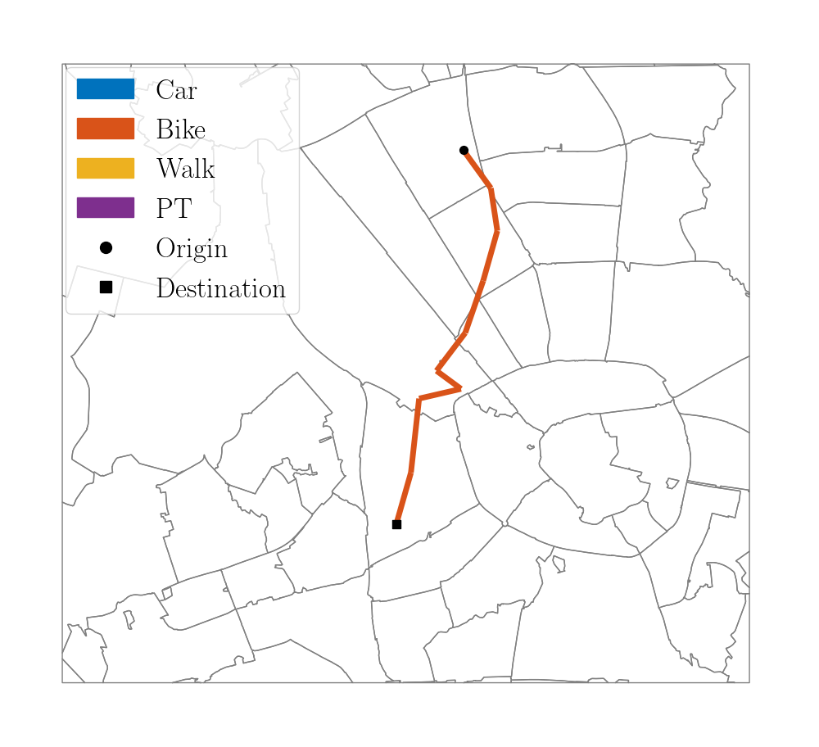
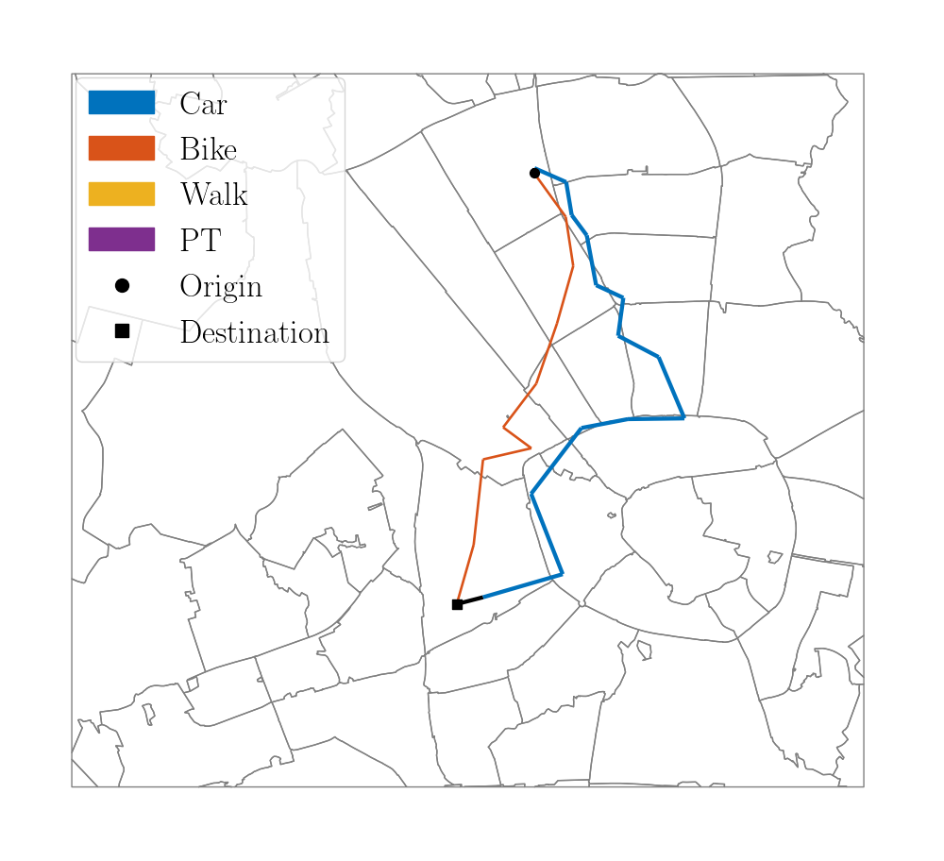
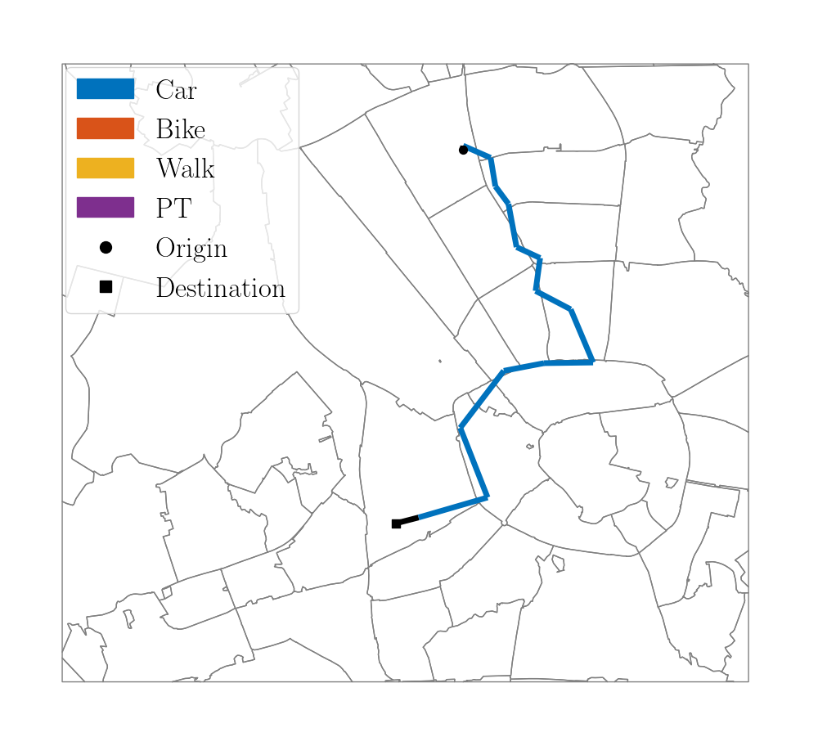
Bike-Car
OD: 212
Utilitarian Efficiency
Commute Sufficiency
Trip Sufficiency

Slide 7
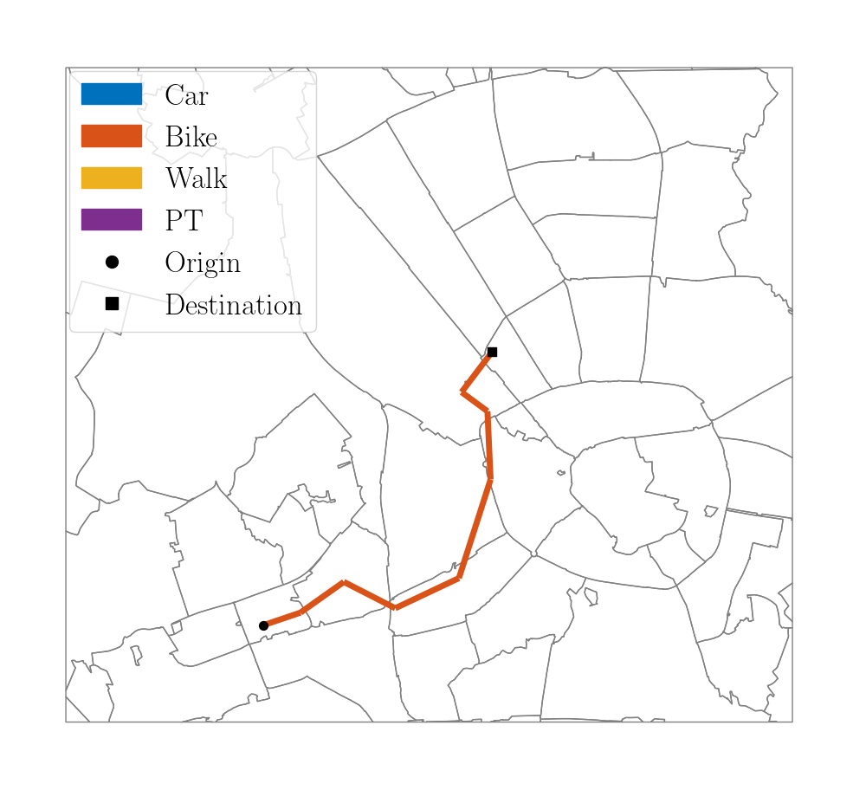
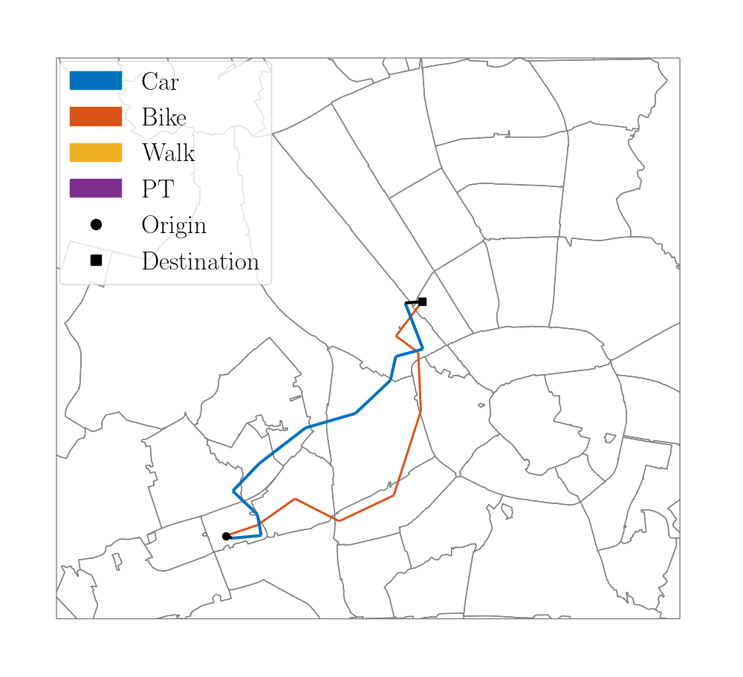
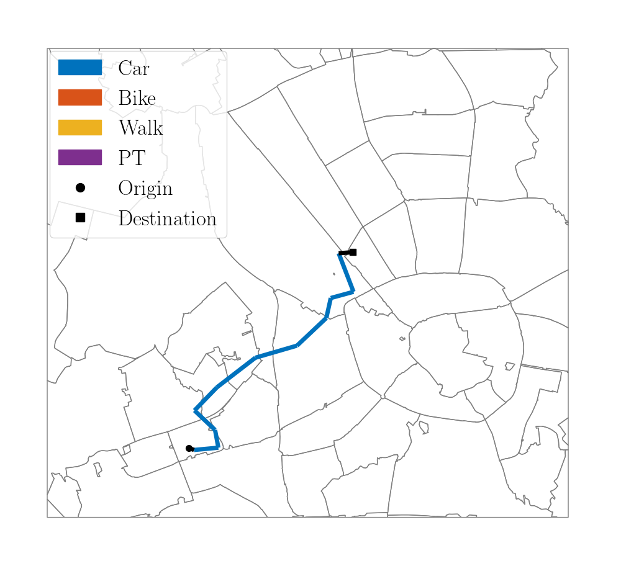
Bike-Car
OD: 278
Utilitarian Efficiency
Commute Sufficiency
Trip Sufficiency

Slide 8
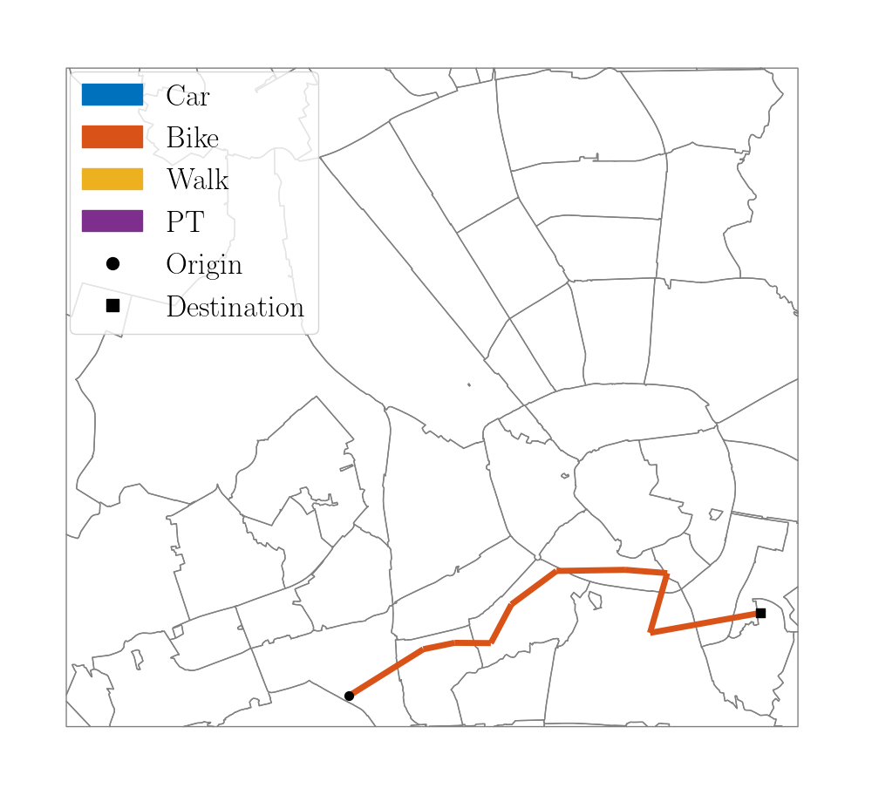
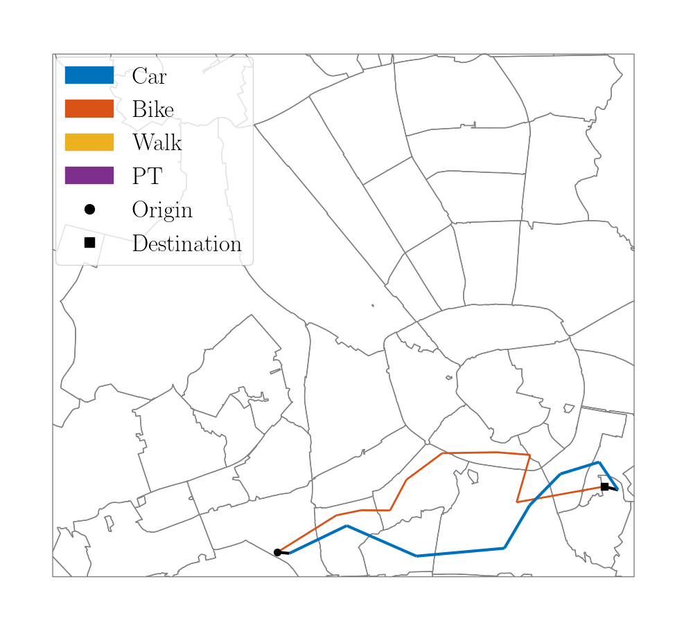
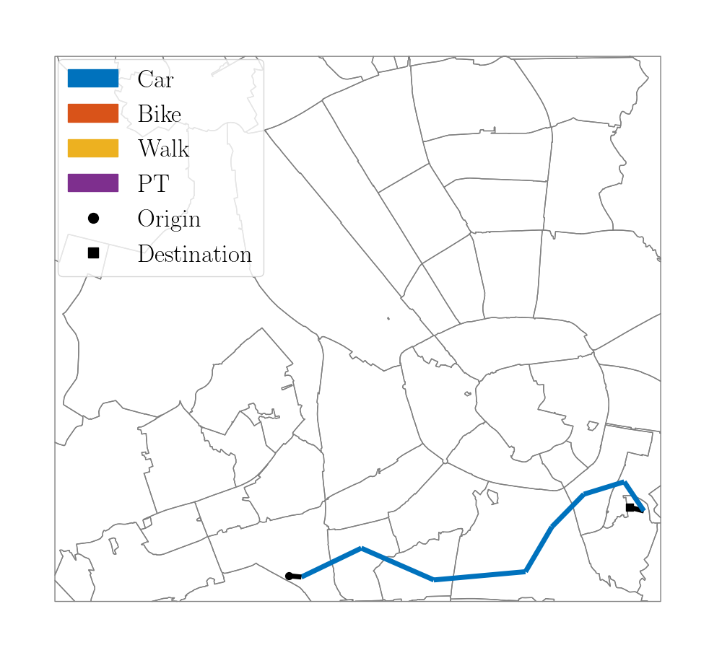
Bike-Car
OD: 337
Utilitarian Efficiency
Commute Sufficiency
Trip Sufficiency

Slide 9
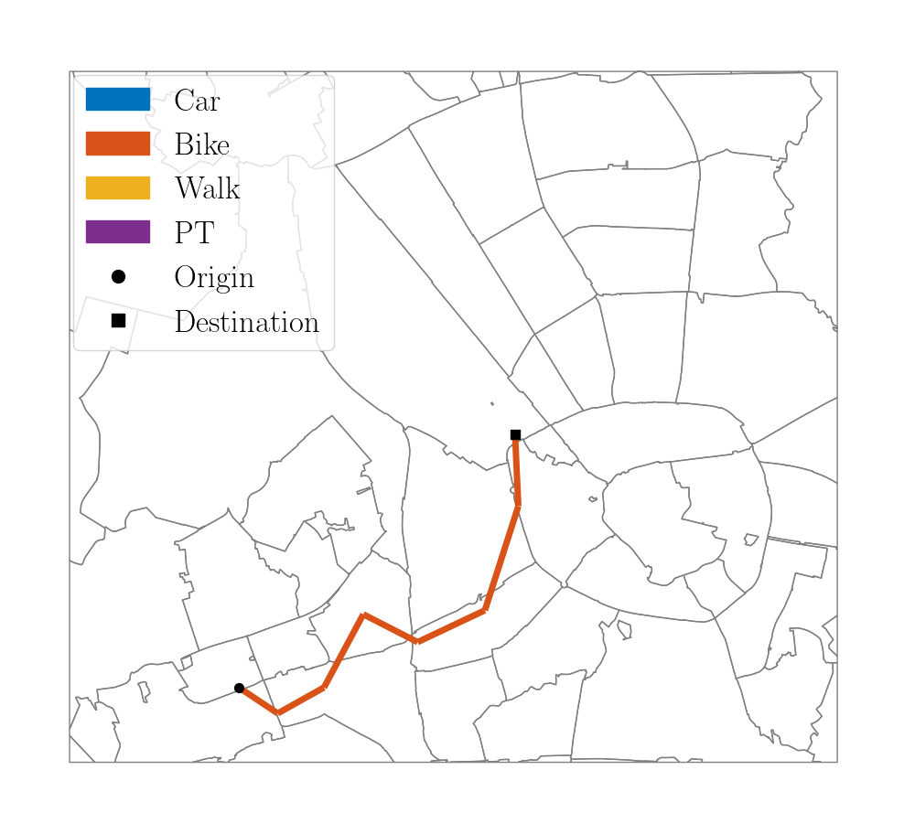
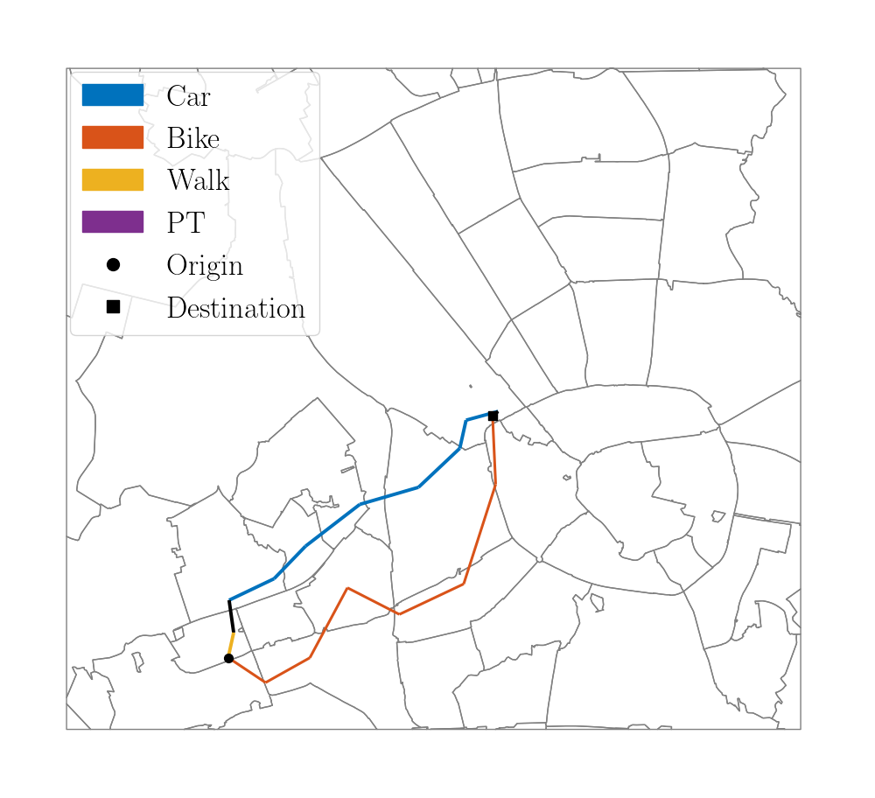
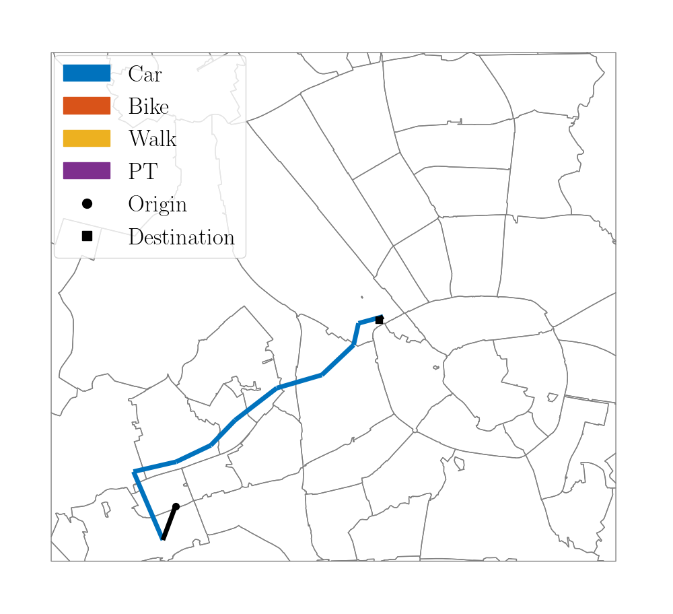
Bike-Car
OD: 386
Utilitarian Efficiency
Commute Sufficiency
Trip Sufficiency

Slide 10
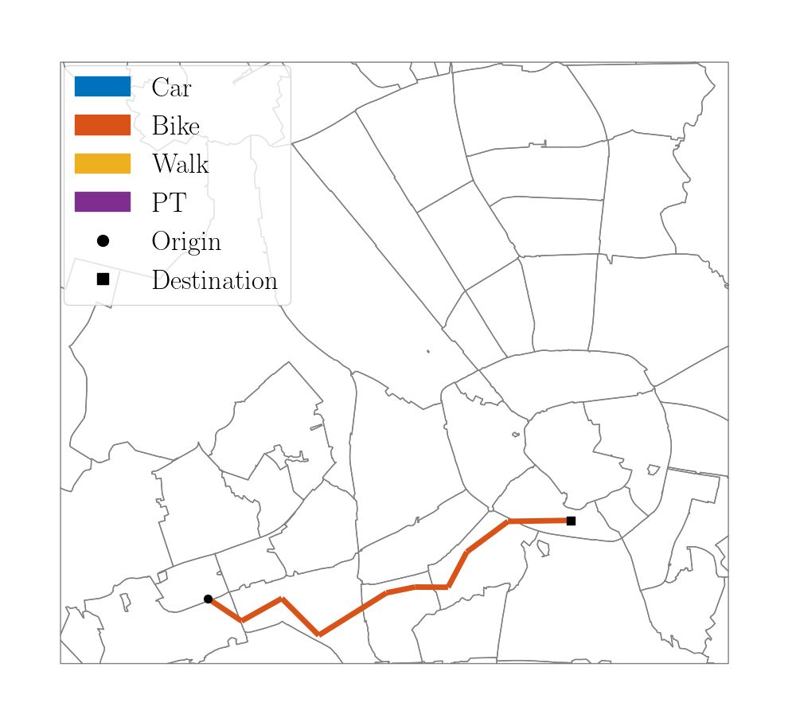
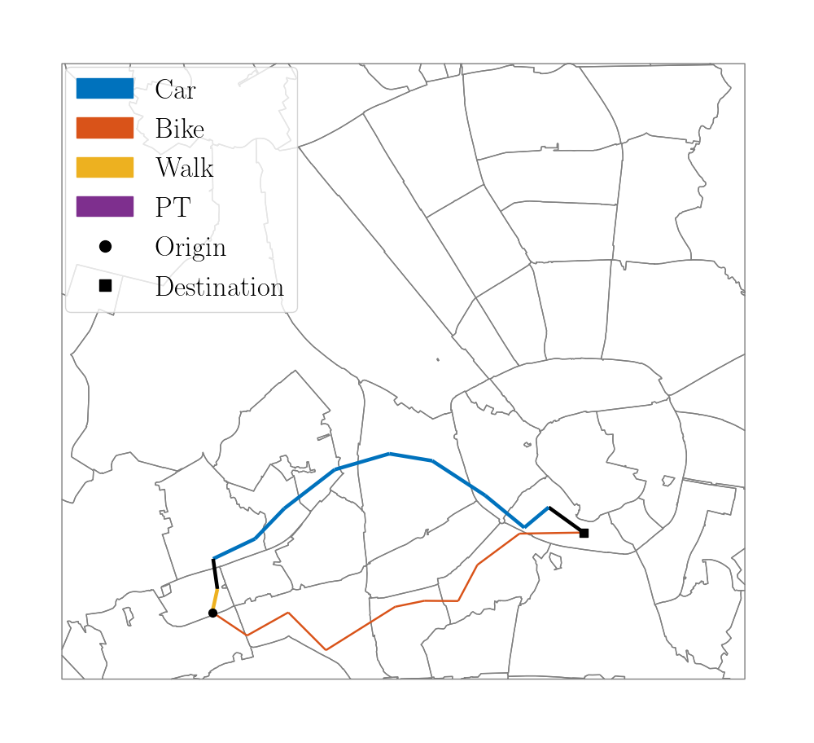
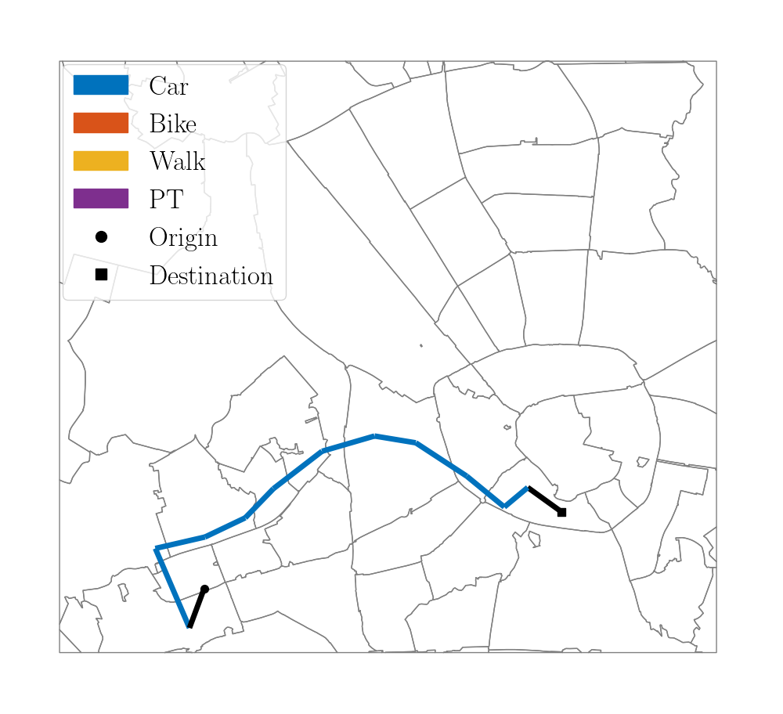
Bike-Car
OD: 388
Utilitarian Efficiency
Commute Sufficiency
Trip Sufficiency

Slide 11
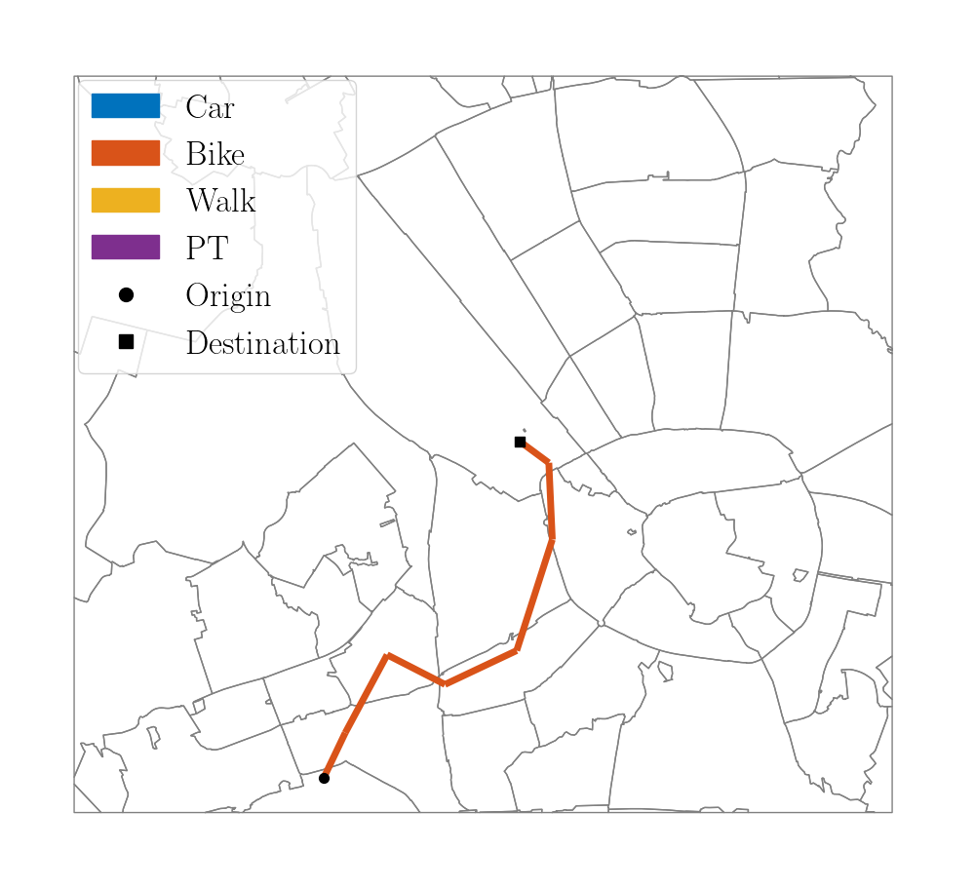
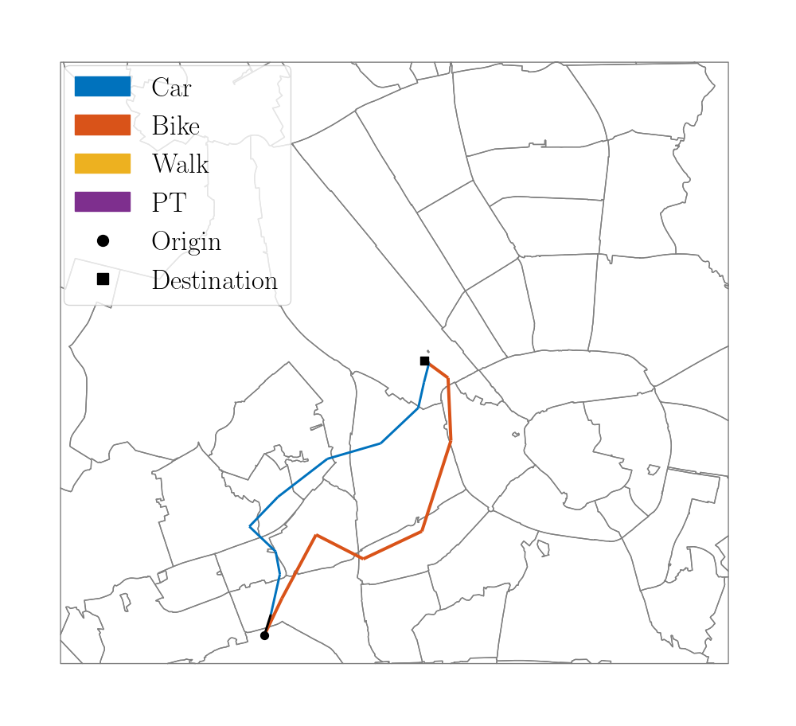
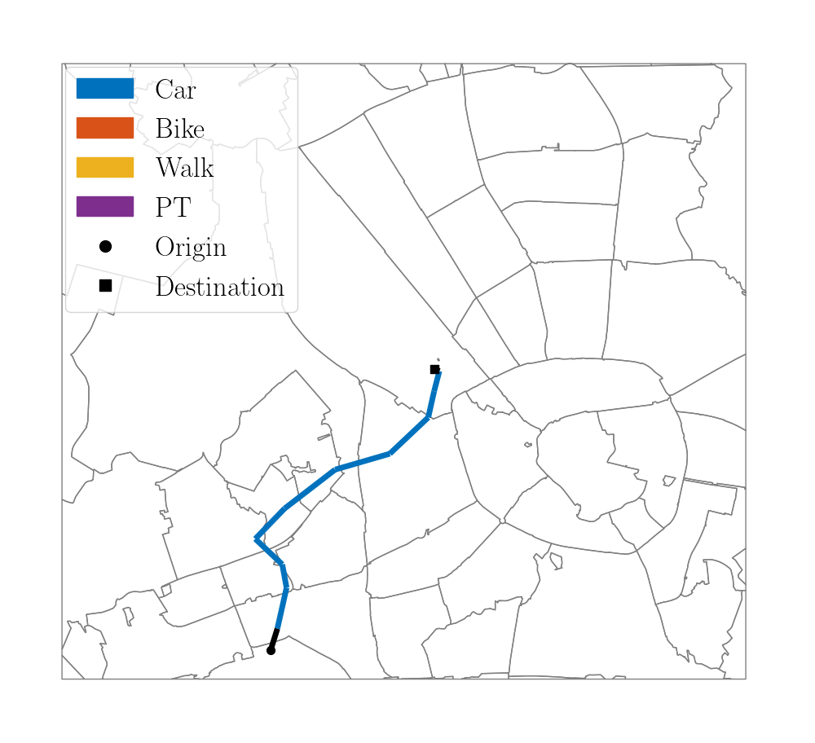
Bike-Car
OD: 460
Utilitarian Efficiency
Commute Sufficiency
Trip Sufficiency

Slide 12
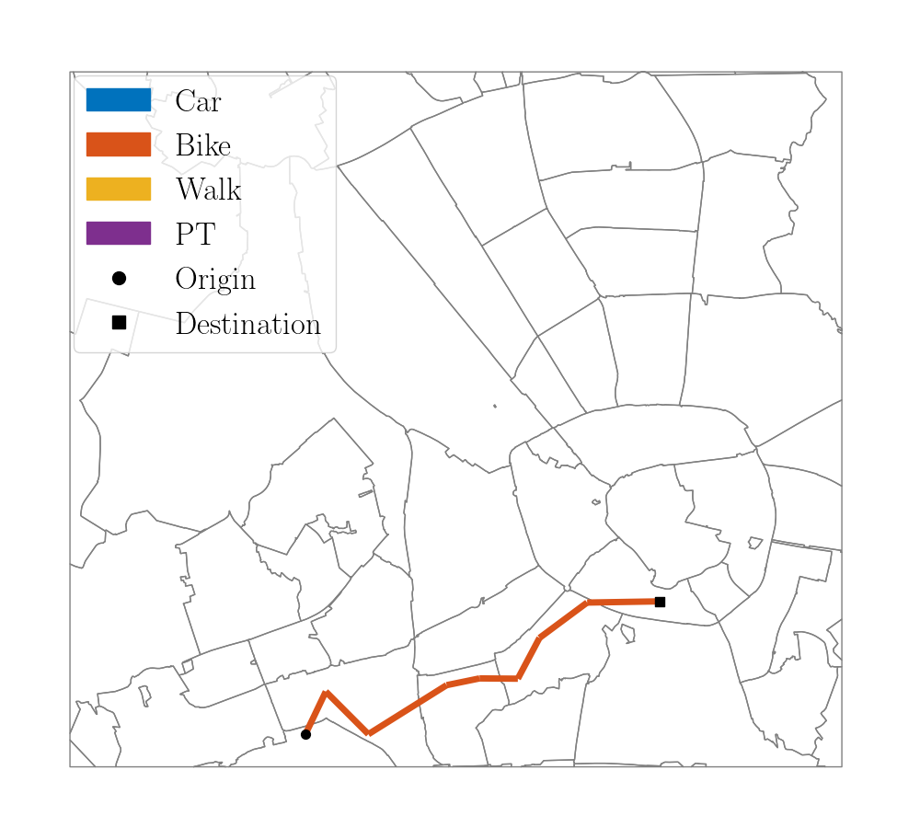
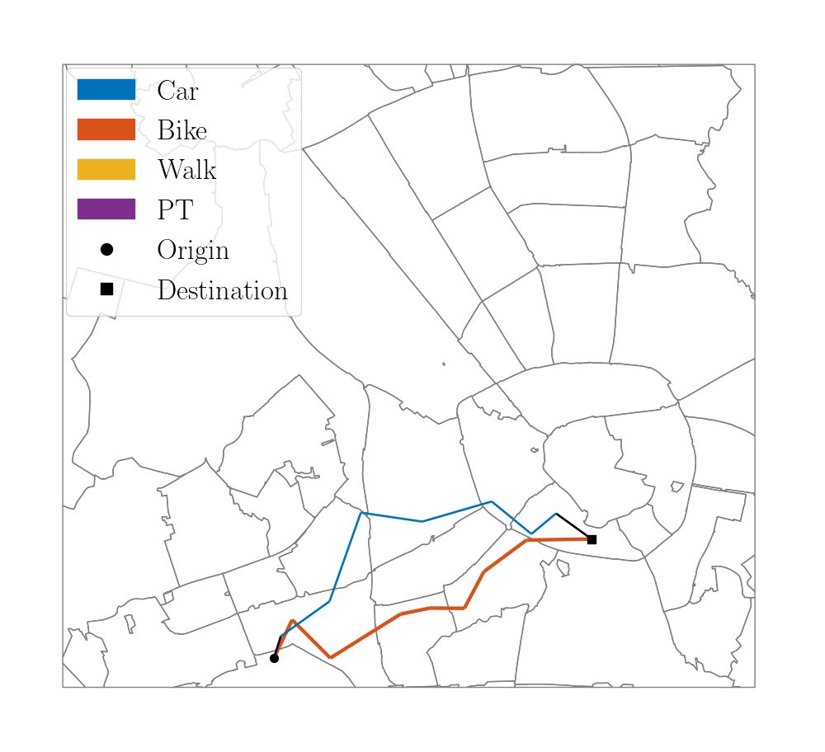
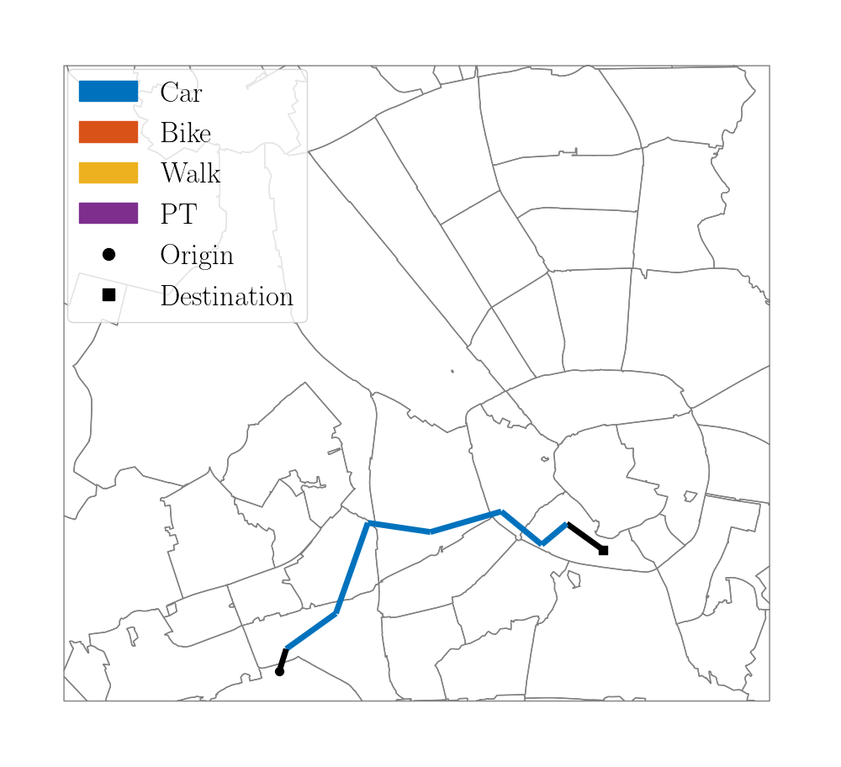
Bike-Car
OD: 462
Utilitarian Efficiency
Commute Sufficiency
Trip Sufficiency

Slide 13
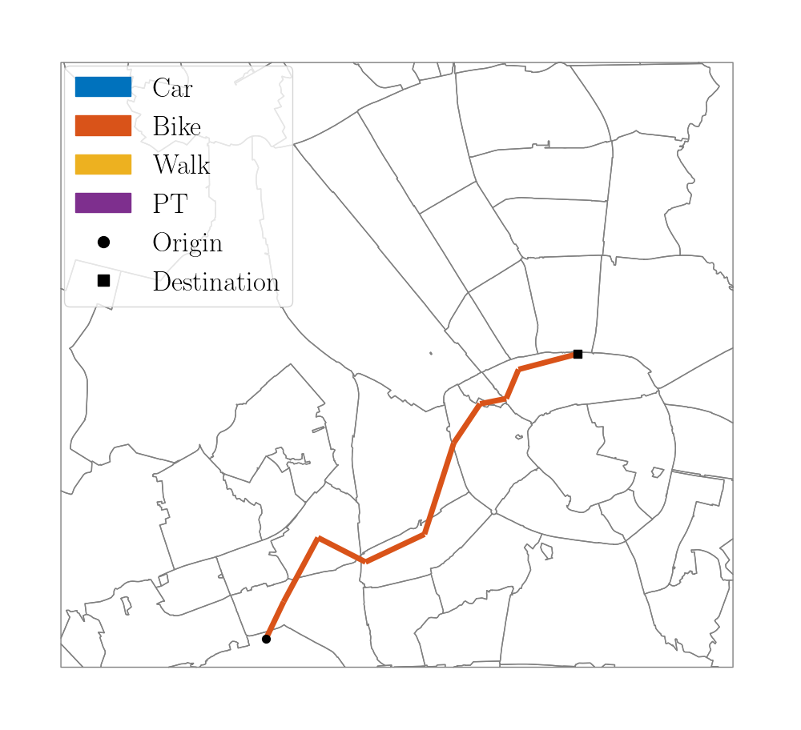
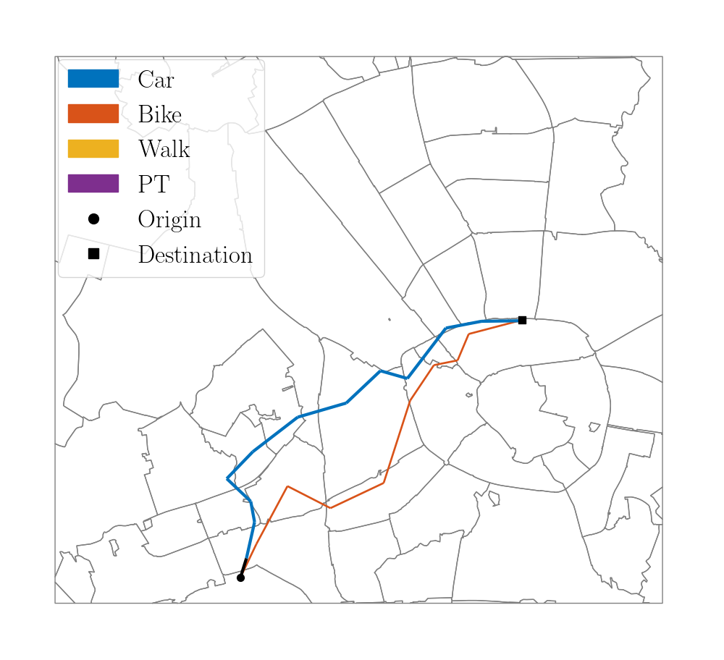
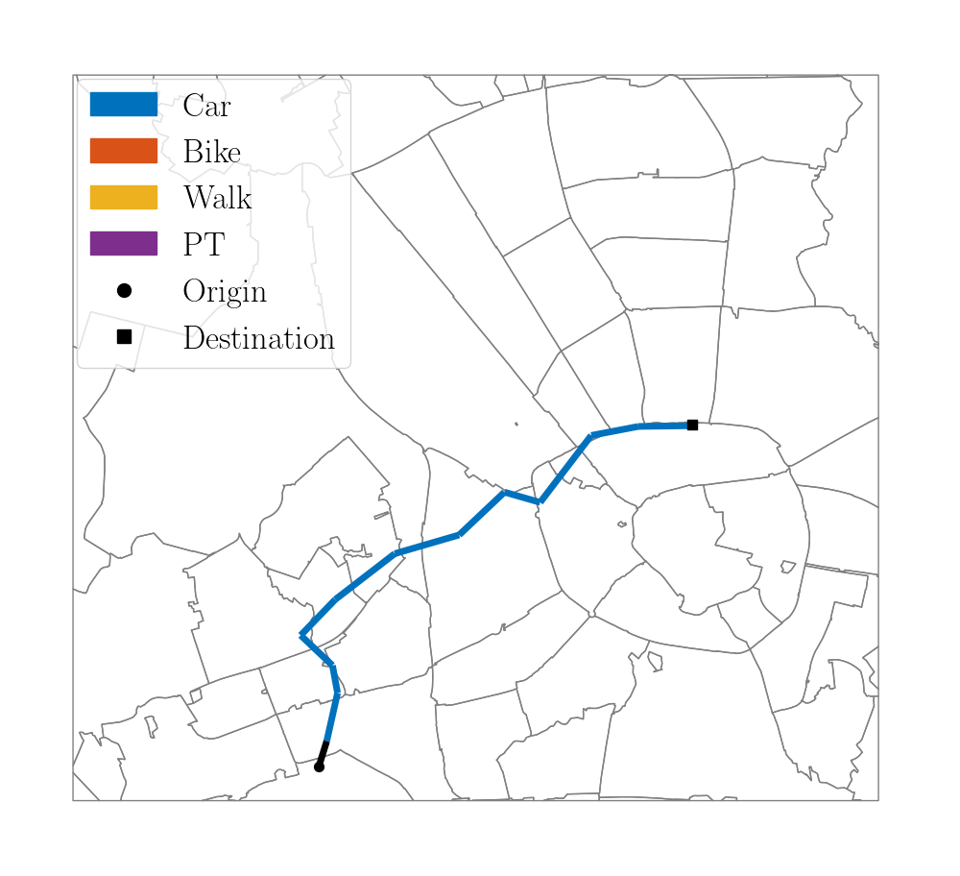
Bike-Car
OD: 465
Utilitarian Efficiency
Commute Sufficiency
Trip Sufficiency

Slide 14
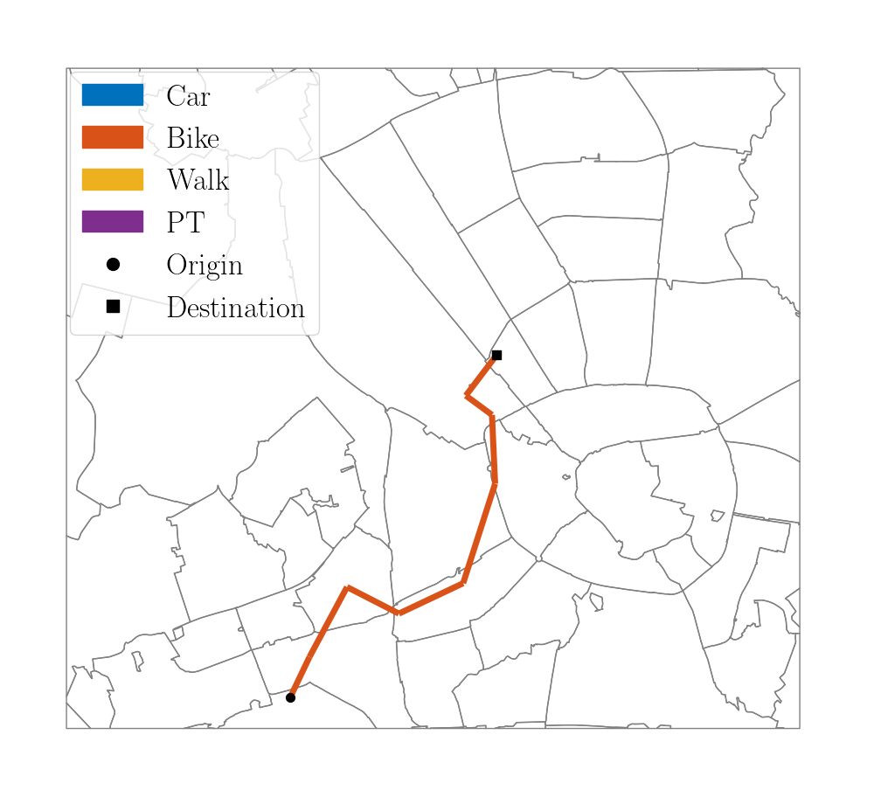
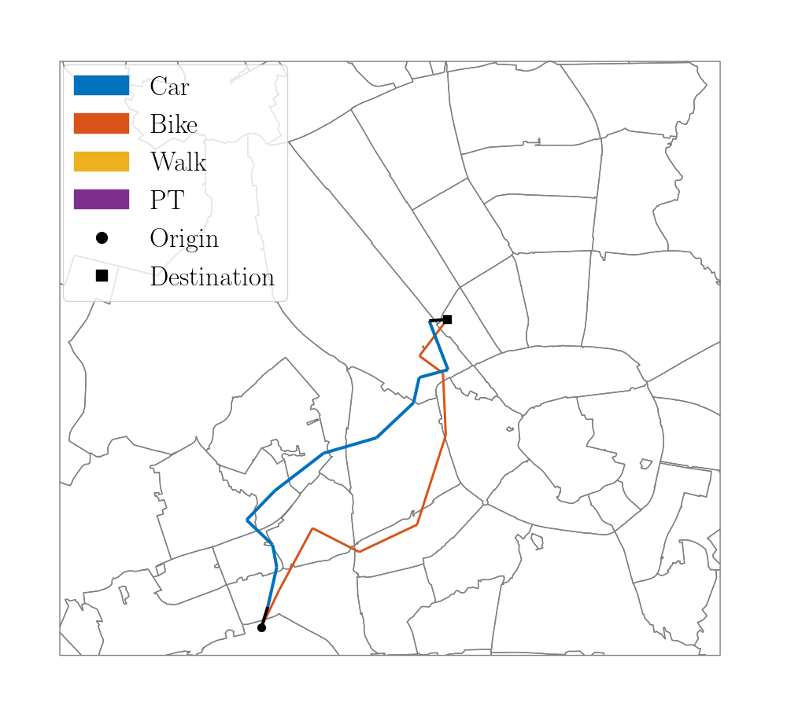
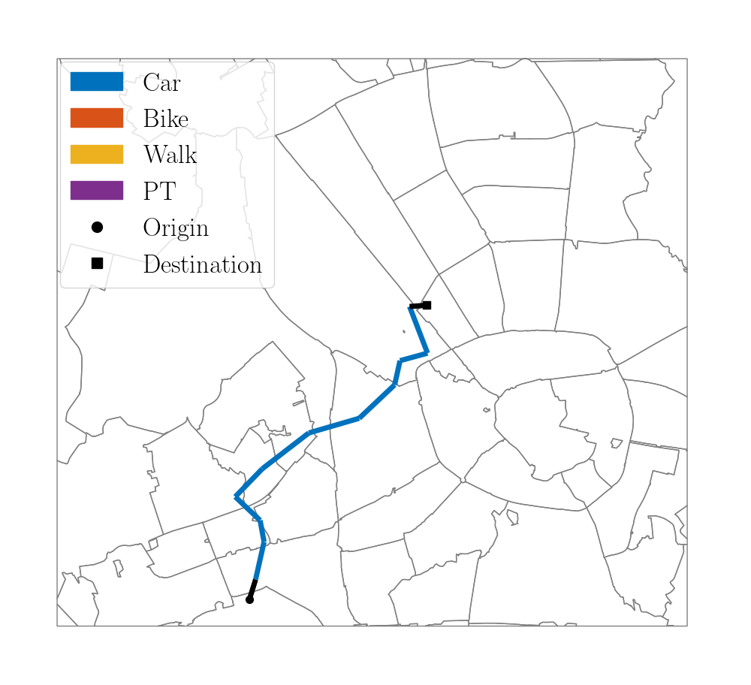
Bike-Car
OD: 470
Utilitarian Efficiency
Commute Sufficiency
Trip Sufficiency

Slide 15
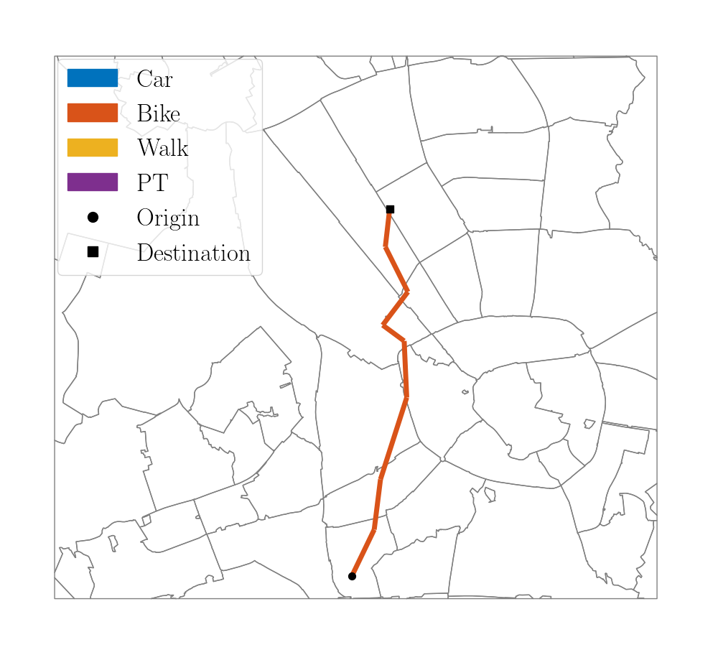
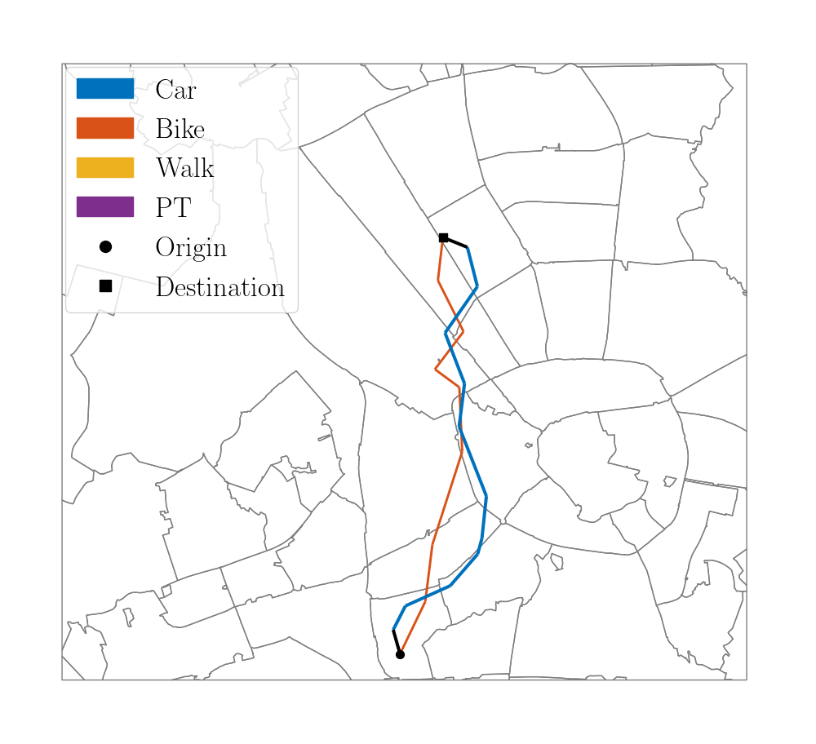
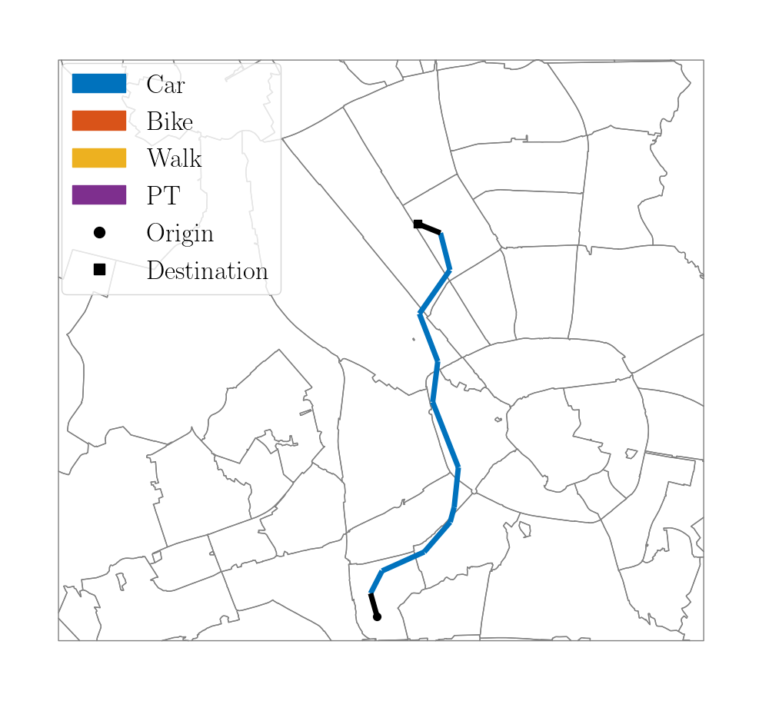
Bike-Car
OD: 487
Utilitarian Efficiency
Commute Sufficiency
Trip Sufficiency

Slide 16
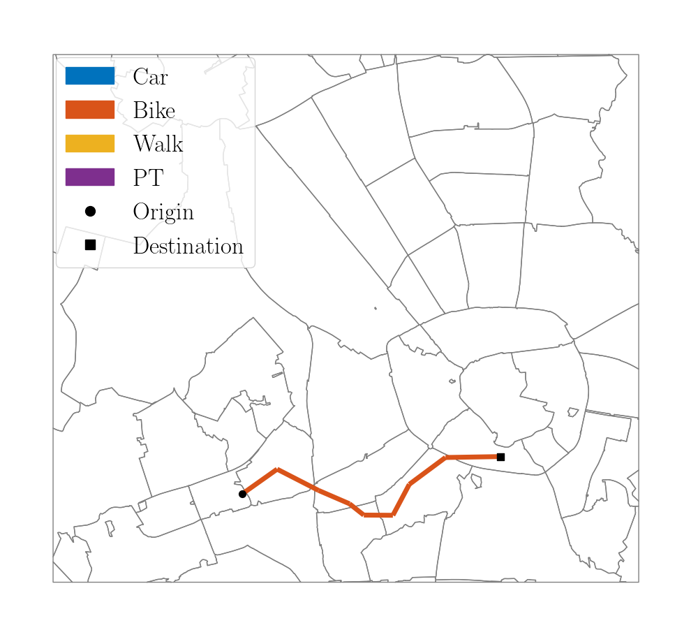
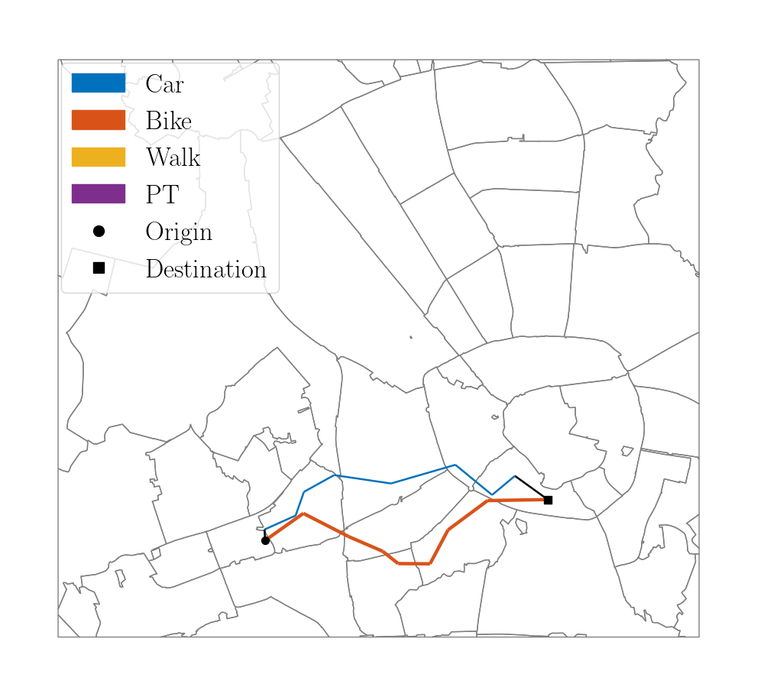
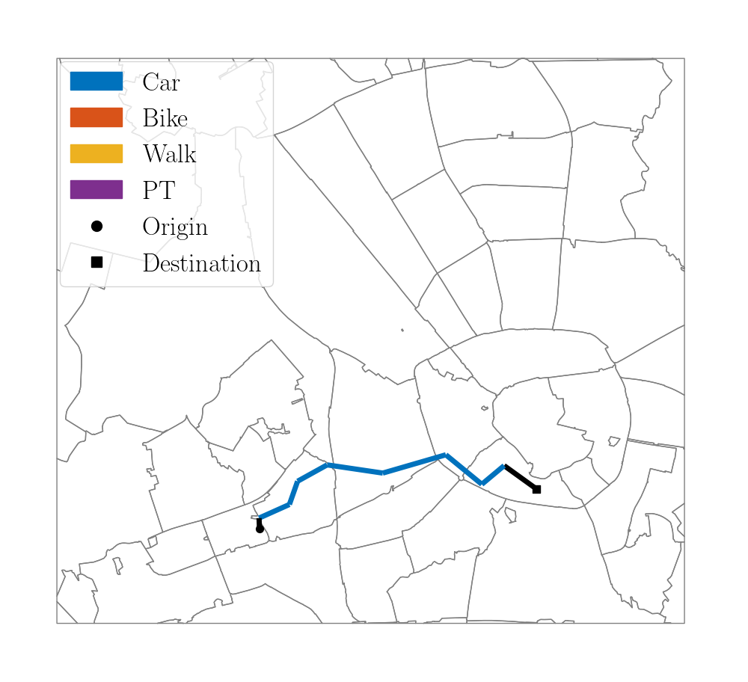
Bike-Car
OD: 595
Utilitarian Efficiency
Commute Sufficiency
Trip Sufficiency

Slide 17
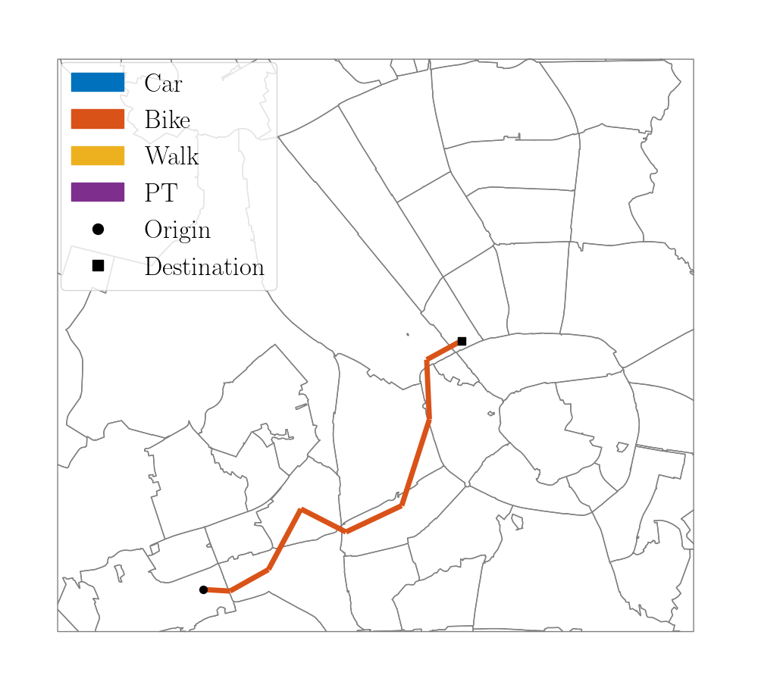
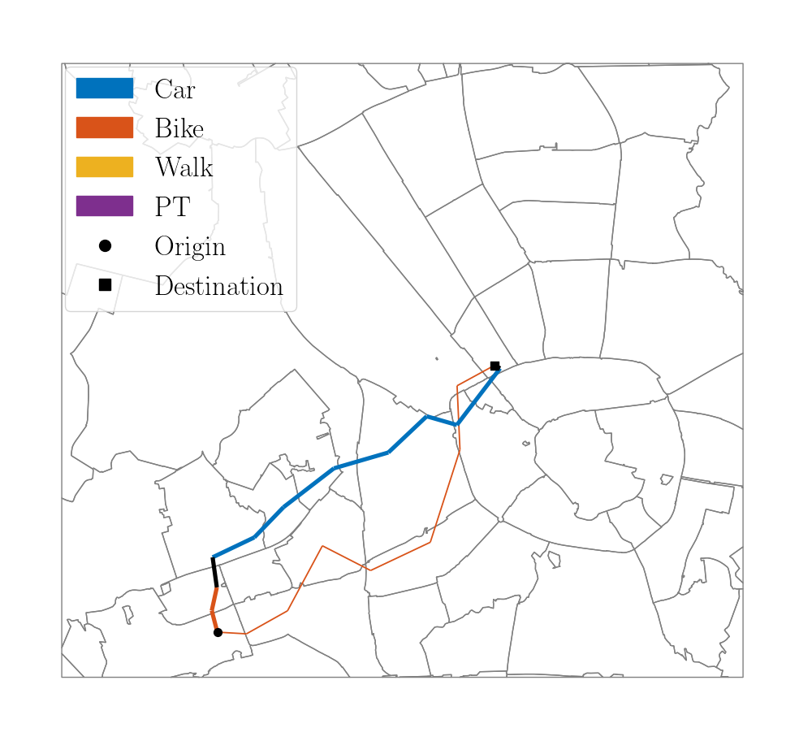
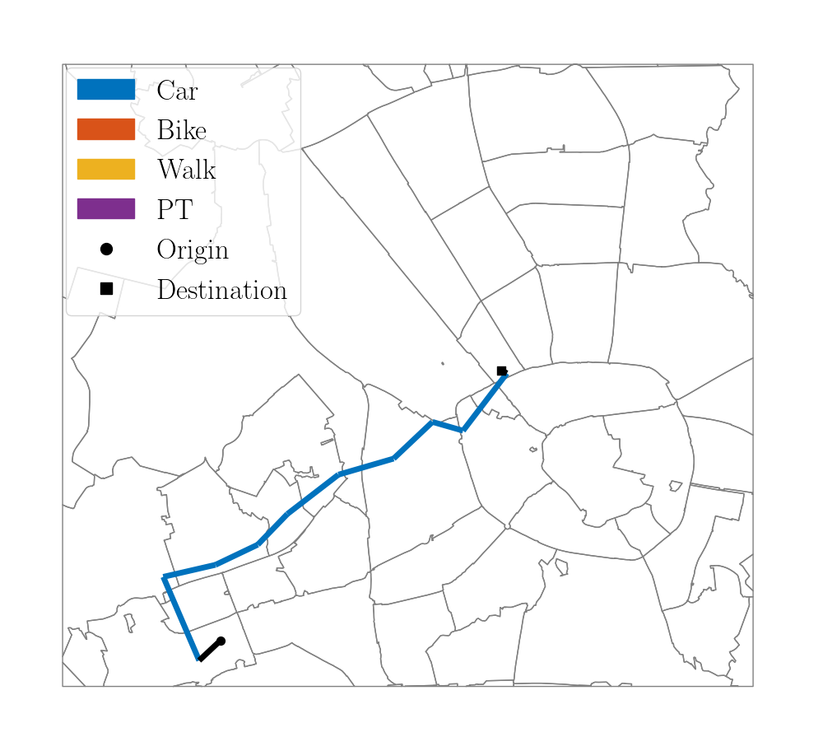
Bike-Car
OD: 624
Utilitarian Efficiency
Commute Sufficiency
Trip Sufficiency

Slide 18

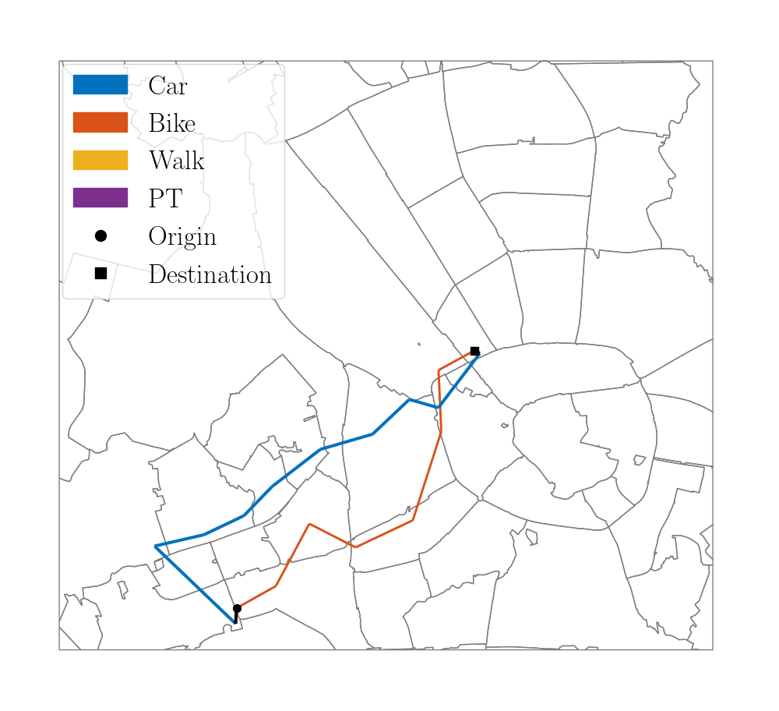
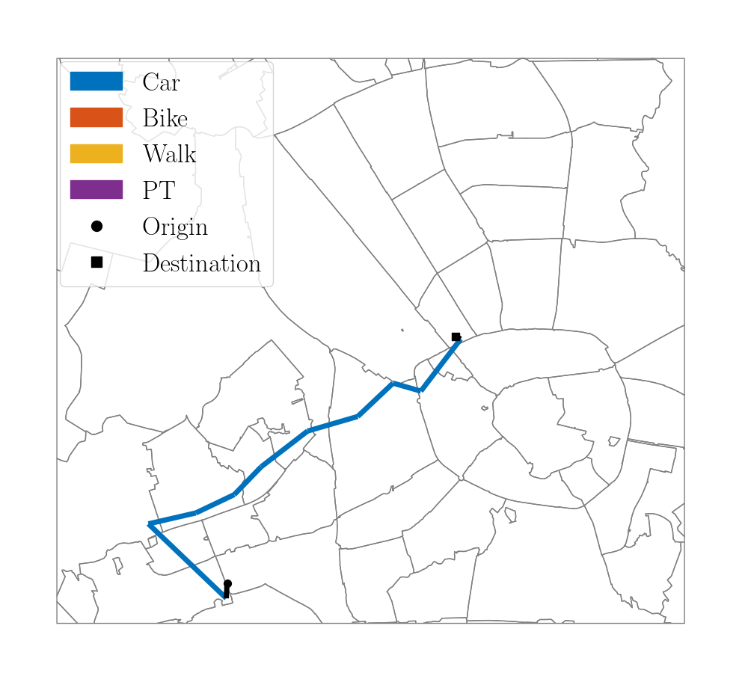
Bike-Car
OD: 711
Utilitarian Efficiency
Commute Sufficiency
Trip Sufficiency

Slide 19
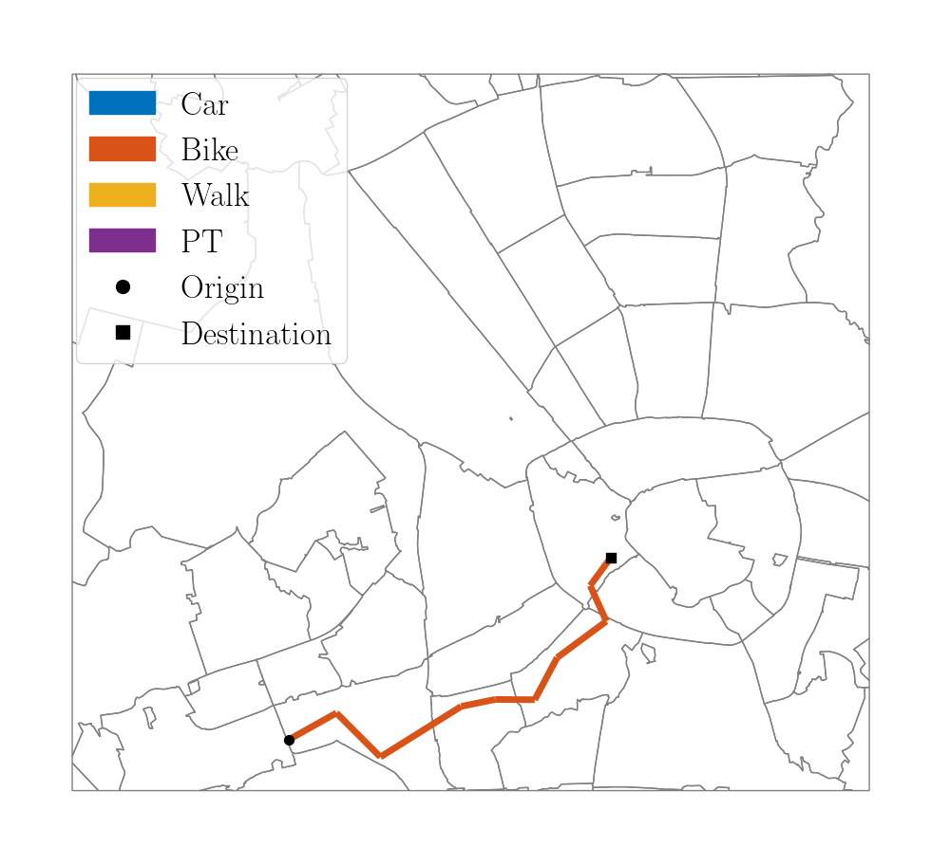
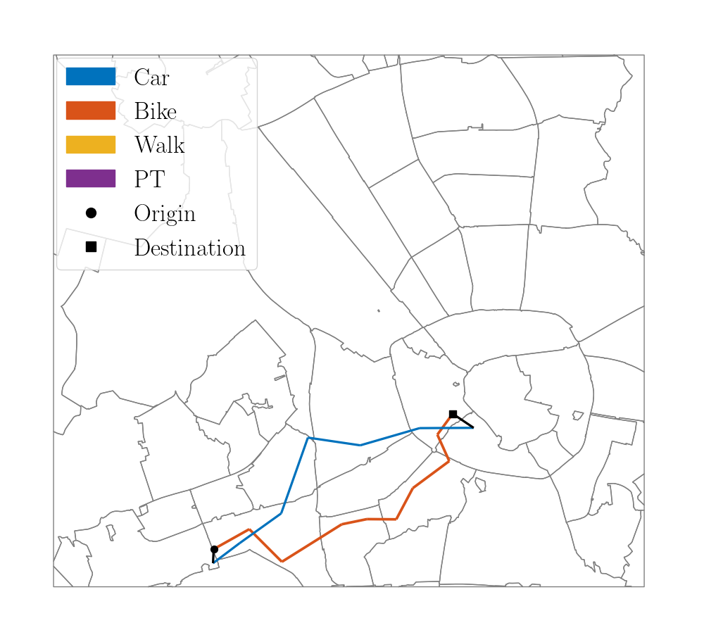
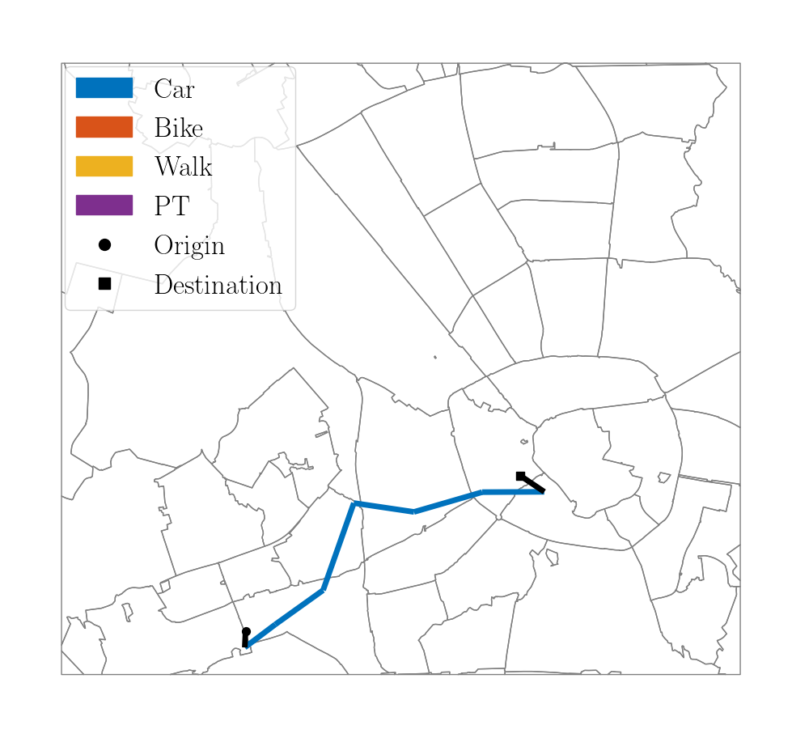
Bike-Car
OD: 715
Utilitarian Efficiency
Commute Sufficiency
Trip Sufficiency

Slide 20
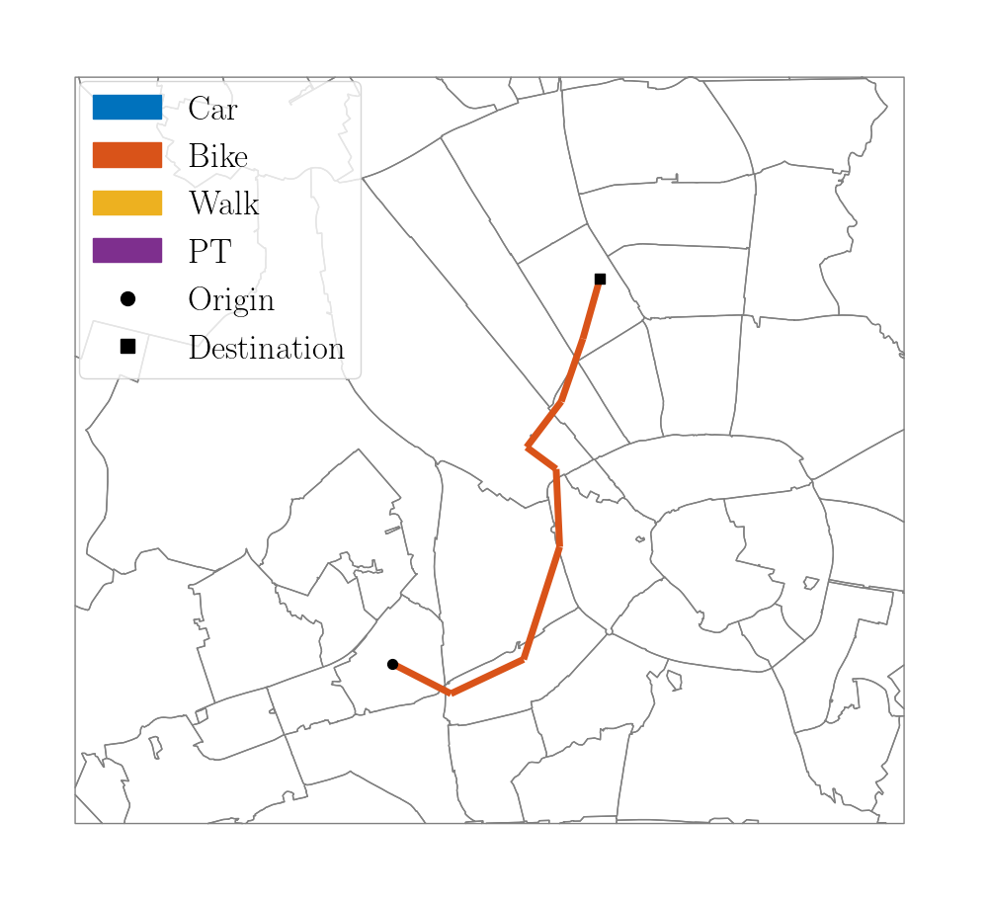
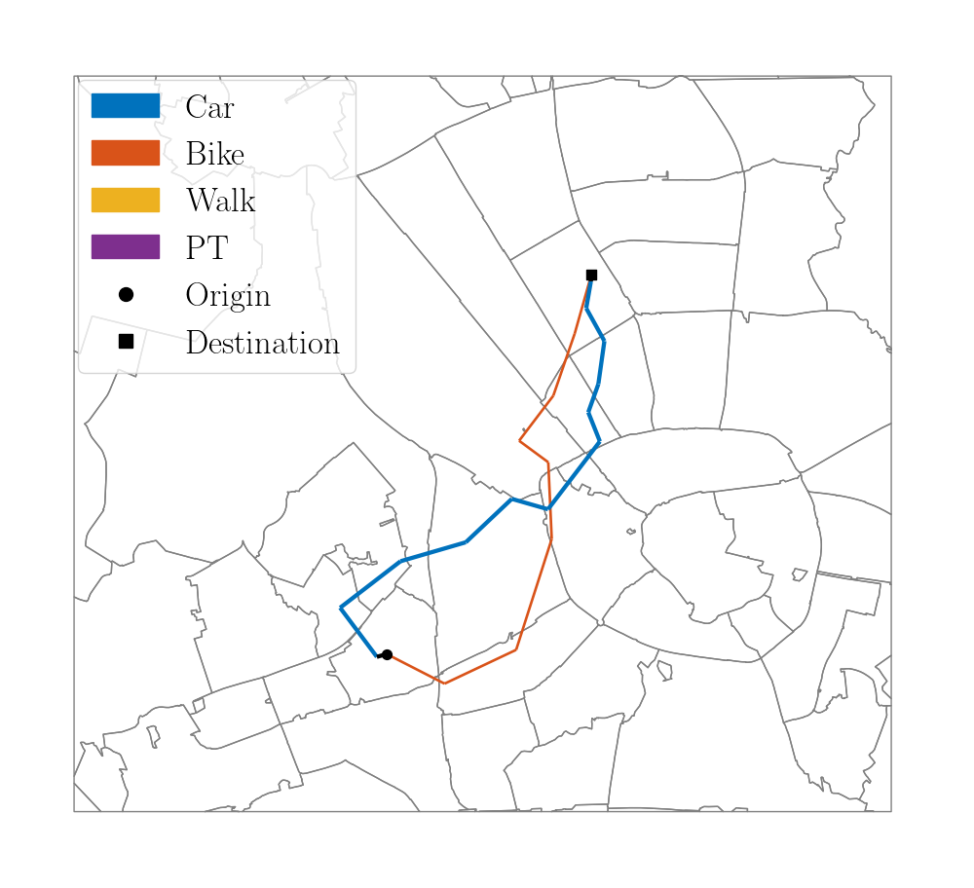
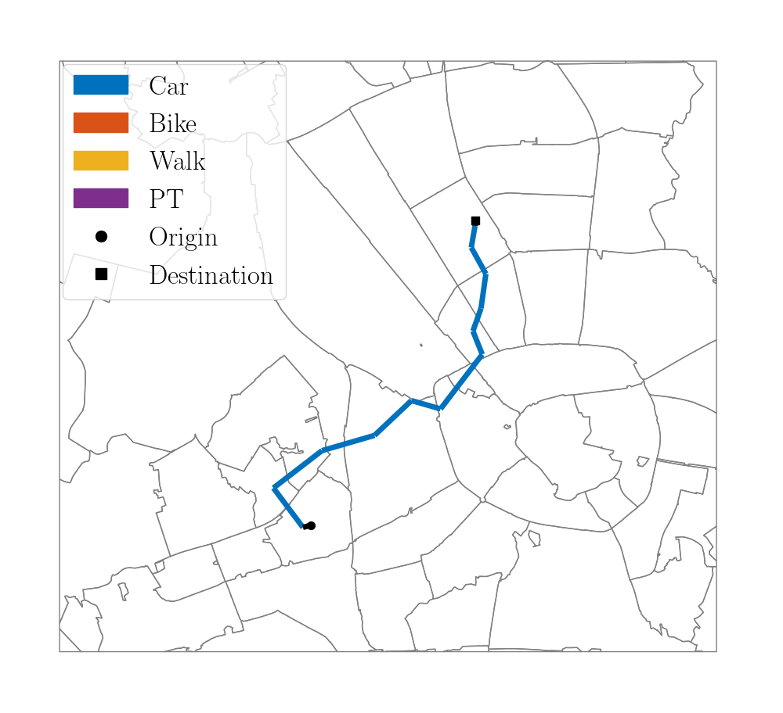
Bike-Car
OD: 1117
Utilitarian Efficiency
Commute Sufficiency
Trip Sufficiency

Slide 21

Accessibility Sufficiency
Using ${\text{FGT}}_{2}$ for MIQP optimization
Bar plots
Heatmaps: We can call it ${\tilde{u}}_{r}$

Slide 22



Accessibility Sufficiency vs Commute Sufficiency

Slide 23



Accessibility Sufficiency vs Trip Sufficiency

Slide 24



Commute Sufficiency
Trip Sufficiency
Destination Sufficiency

